Slide 1
OFNC LEEDS: Our Vision
Osahon Ogbeiwi
Area Secretary, OFNC Leeds
On Behalf of BEC

Slide 2
To Our Leaders Past
Appreciation
“The labours of our heroes past …”
(Nigerian National Anthem)

Slide 3
Our Promise – Leadership A Divine Privilege
Thank God and everyone for the trust.
We shall…
“Walk worthy of the calling with which we were called”
(Ephesians 4:1)

Slide 4
Our Calling – To Build on …
“For we are God’s fellow workers…”
“For no other foundation can anyone lay than that which is laid, which is Jesus Christ.”
(1 Corinthians 3:9,11)

Slide 5
OFNC National Motto
Everyone a Faithful Disciple
of Christ
OFNC =
A Discipleship Ministry (Matthew 28:19)

Slide 6
Our Vision – To Grow
Development + Improvement = Growth
Our activities – DEVELOPMENTAL.
Our results – PROGRESSIVE.
Habakkuk 2:1,2 – With ‘foresight’ &
a ‘flint-like attitude’, we Tarry no longer!
Write Ex-Plain Read RUN Time

Slide 7
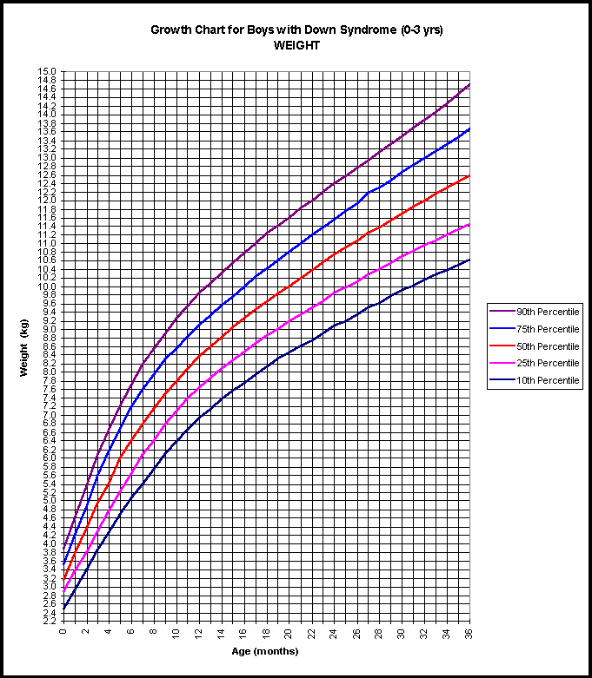
Our Prayer: Your Increase towards your Goals
Spiritual
FUTURE
Economic
Social
Family
Personal
Where do you see yourself on these development routes five years from now?
NOW

Slide 8
Your Growth Measure?
Your Pre-destination: Conformity to the image of the Son… (Romans 8:29)
Faith
Virtue
Knowledge
Self-Control
Perseverance
Godliness
Brotherly Kindness
Love
Your journey: from Faith to Love (2 Peter 1:5-7)
Your Target: CHRIST
“Till we all come to the unity of the faith, and of the knowledge of the Son of God, to a perfect man, to the measure of the stature of the fullness of Christ; that we should no longer be children tossed to and fro and…” (Ephesians 413-14)

Slide 9
Our Mission – To minister in Jesus Name
A Family Ministry Approach
Children’s ministry
Youth-Teen’s ministry
Young Adult’s ministry
Women’s ministry
Men’s ministry
Welfare ministry
Evangelism ministry
Teaching ministry
Music ministry
Prayer ministry
SAME WAYS?
NEW IDEAS?

Slide 10
Our Proposal – Stewardship Needs
Upgrade to BEC Status?
Music Coordinator
Young Adults Coordinator
(for singles, 18+ and above)
Organising Secretary
(and BCC Rep)

Slide 11
Our Charge – Get Involved!
“Let us Rise up and Build” (Neh 2:18)
Join: A Ministry Group
Volunteer: Ad hoc Service Committees
Building together with God: involves T.E.A.M. work
T = Together
E = Everyone
A = Achieves
M = More

Slide 12
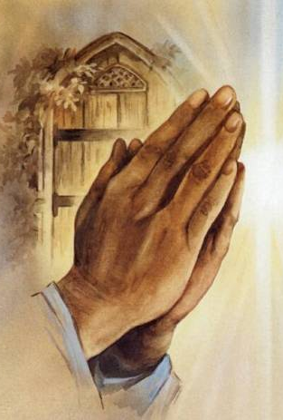
Our Need – Your Prayer
PLEASE
PRAY
FOR
US
ALWAYS!

